Slide 1
Intrusion Detection System with Machine Learning Algorithms and Comparison Analysis
Submitted in the partial fulfillment for the award of the degree of
BACHELOR OF ENGINEERING
IN
ARTIFICIAL INTELLIGENCE & MACHINE LEARNING
Submitted by:
KARAN ANAND JAIN
21BCS8804
Under the Supervision of:
Prof. Siddharth Kumar
Department of AIT-CSE
DISCOVER . LEARN . EMPOWER

Slide 2
Outline
Introduction to Project
Problem Formulation
Objectives of the work
Methodology used
Results and Outputs
Conclusion
Future Scope
References

Slide 3
Introduction to Project
With the rise of technology, computer systems and networks have become increasingly important in today's world.
The manual systems of businesses, enterprises, and organizations have been replaced with computerized solutions due to the fast-paced changes happening in the world.
Consequently, a vast amount of data/information is generated and stored in these systems, requiring security measures to be put in place.
Information Security is the key to preventing unauthorized access, modification, and destruction of physical or electrical information.
The primary objectives of Information Security are Confidentiality, Integrity, and Availability (CIA).

Slide 4
To maintain the security of a network or system by constantly monitoring for any unauthorized or malicious activity.
An Intrusion Detection System is a crucial tool in ensuring the safety and protection of sensitive data and assets.
The process of detecting an intrusion occurs beyond the firewall's scope. While prevention of unauthorized access is preferable, it may not always be feasible.
Intrusion Detection refers to the real-time surveillance and examination of data and network activity to identify potential vulnerabilities and ongoing attacks.

Slide 5
It operates by utilizing a predefined set of rules to identify potential intrusions and prevent them from occurring.
Some of the advantages of Information Security include protection against malicious attacks and securing confidential information.
Over the years, Information Security has evolved and offers various areas of specialization, including Network Security, Allied Infrastructure Security, and more.
Intrusion Detection Systems currently rely on either signature-based detection or anomaly-based detection to identify intrusions, but both methods have their drawbacks.

Slide 6
Objective
The objective of an Intrusion Detection System (IDS) is to ensure the security and reliability of a system. It works by identifying intrusions and generating alerts based on predefined rules for any detected intrusions within a network or system.
There are two main categories of IDS: Host-based Intrusion Detection System (HIDS) and Network-based Intrusion Detection System (NIDS).
The process of detecting an intrusion occurs beyond the firewall's scope.
The detection method used by IDS can be Signature-based or Anomaly-based.

Slide 7
Methodology
The proposed work is implemented in Python 3.6.4 with libraries scikit-learn, pandas, matplotlib and other mandatory libraries. We downloaded dataset from kdd.ics.uci.edu.
The data downloaded contains train set and test set separately with four different classes of intrusions.
The train dataset considered as train set and test dataset considered as test set.
Compared with other classification algorithms, Decision Tree, Logistic regression, Random Forest and KNN can better solve the problems of small samples, nonlinearity and high dimensionality.

Slide 8
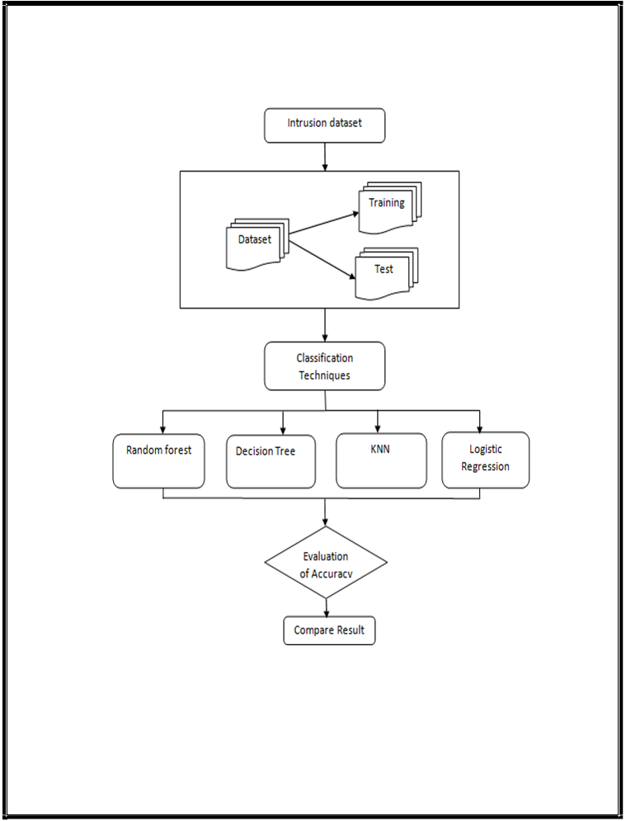
Architecture of System

Slide 9
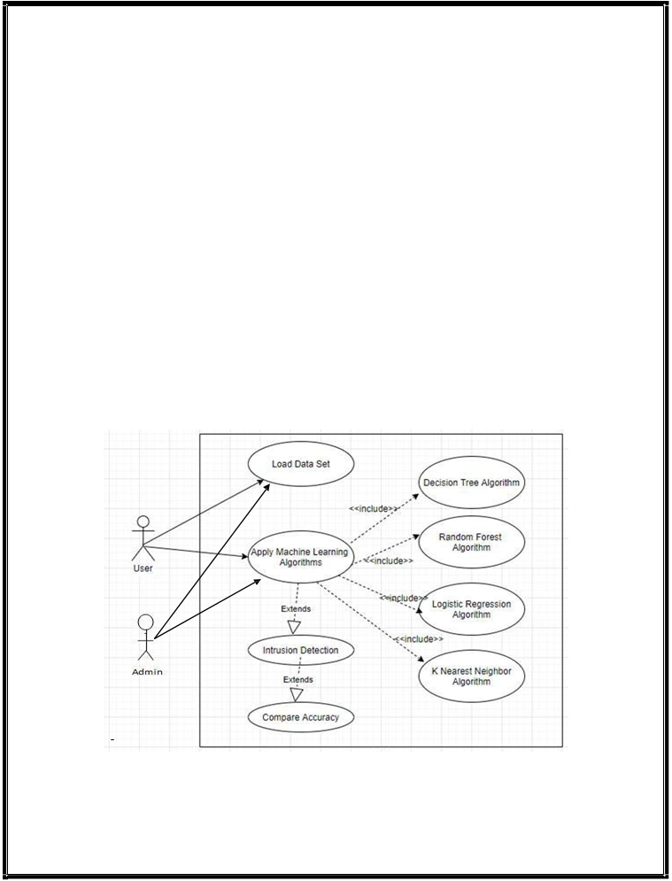
Use Case Diagram

Slide 10
Results and Outputs
The main disadvantage in the existing IDSs is the higher rate of false alarms.
To excel in the reliability of a security system, we need to lower the rate of false alarms or false positives.
The system that has been proposed helps to detect the true attacks because of the four machine learning algorithms that have been implemented.
The use of machine learning algorithms helps us to classify the true attacks and false alarms, thus helping us to build good IDS that can decrease the false alarm rate and can provide reliability and security.

Slide 11
Traditional IDSs available today has its own relative weaknesses and strengths.
While one solution may be strong at host-based intrusion detection, the other solution may be strong at network-based intrusion detection.
Rule-based architecture and machine learning techniques were used to compare security events. These methods analyze alerts generated from various sensors, which are normalized and combined into meta-alerts, then it used to classify true alerts or false alarms.

Slide 12


Slide 13
Conclusion
The main aim of Intrusion Detection System is to detect the attacks and malicious activities that occur within a network and to reduce the rate of false positives.
By using the machine learning algorithms, the output of the IDS would be accurate, advanced and reliable.
This system also shows the accuracy rate of the attacks that have been detected by the different machine learning algorithms that have been implemented.
The incremental increase in the use of technology has led to huge amount of data that needs to be processed and stored securely for the users and Security is a major aspect for any user.

Slide 14
Future Scope
The system that has been proposed can be made more reliable and efficient by implementing other machine learning algorithms along with the ones that already have been implemented so that intrusion can be detected easily.
Also the other types of attacks can also be classified as the classes of intrusion to identify more attacks and provide more security and reliability. Thus further development of the system can help to increase the detection rate and lower the false positive rates.

Slide 15
References
A B. Athira, V. Pathari, “Standardisation and Classification of Alerts Generated by Intrusion Detection Systems”, IJCI, International Journal on Cybernetics & Informatics, Vol 5 Issue 2, 2016.
Johansson Daniel, Andersson Par, “Intrusion Detection Systems with Correlation Capabilities”
Yasm Curt, “Prelude as a Hybrid IDS Framework”, March, 2009
Kumar Vinod, Sangwan Prakash Om, “Signature Based Intrusion Detection System Using SNORT”, IJCAIT, International Journal of Computer Applications & Information Technology, Vol. I, Issue III, November 2012.
Singh Deepak Kumar, Gupta Jitendra Kumar, “An approach for Anomaly based Intrusion detection System using SNORT“, IJSER, International Journal of Scientific & Engineering Research, Volume 4, Issue 9, September 2013.
S, Vijayarani, and Maria Sylviaa S. “Intrusion Detection System – A Study”, IJSPTM, International Journal of Security, Privacy and Trust Management ,Vol 4, Issue 1, pp. 31–44, February 2015.
Yang Guangming, Chen Dongming, Xu Jian, Zhu Zhiliang, “Research of Intrusion Detection System Based on Vulnerability Scanner”, ICACC, Advanced Computer Control, March 2010.
Chakraborty Nilotpal, “Intrusion Detection System and Intrusion Prevention System: A Comparative Study”, IJCBR, International Journal of Computing and Business Research , Volume 4 Issue 2, May 2013.
Kothari Pravin, “Intrusion Detection Interoperability and Standardization”, February, 2002.
TIMOFTE Jack, “Intrusion Detection using Open Source Tools”, Revista Informatica Economica nr.2(46), pp. 75-79, 2008.

Slide 16
THANKING YOU !

